Slide 1
EP1000
Computer Controlled Cutting 2 Assignment

Slide 2
Lasercut Parametric Box
Boxes are useful in all projects as they provide housing or containment.
Making the box parametric allows changes, accommodating for boxes of different sizes, types.
A practical example that can be used for other projects.

Slide 3
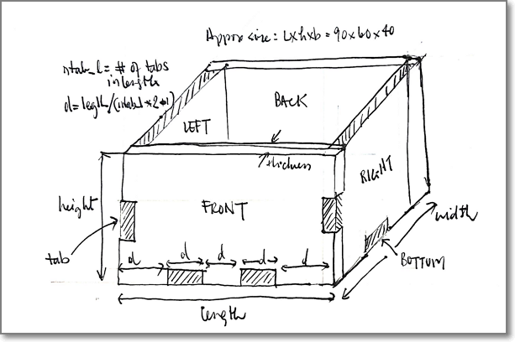
Start with a sketch
Sketch on paper how your box looks like and the approximate dimensions.

Slide 4
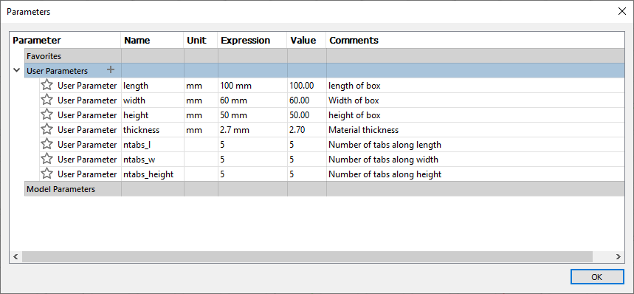
Define the parameters

Slide 5
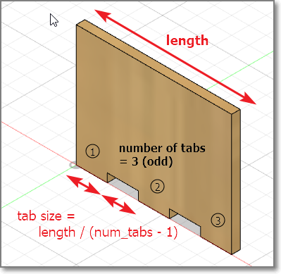
Basic Calculations
Odd number of tabs
Tabs and spacers have same size
Do NOT use the sketch > rectangular pattern to duplicate.
You CAN use the 3D create > pattern to duplicate the feature.

Slide 6
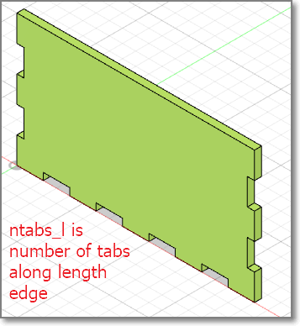
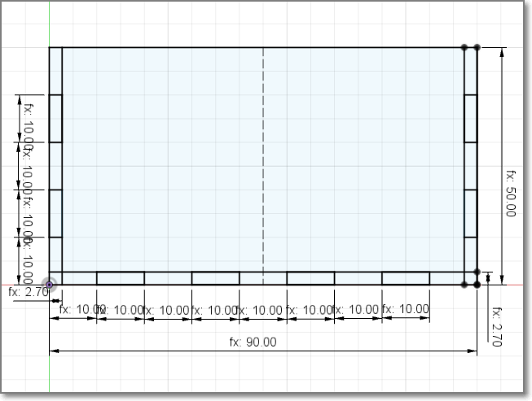
Create the front face
Make a new component
Sketch the face
Add the tabs
tabLength = length/(ntabs_1*2-1)
Extrude

Slide 7
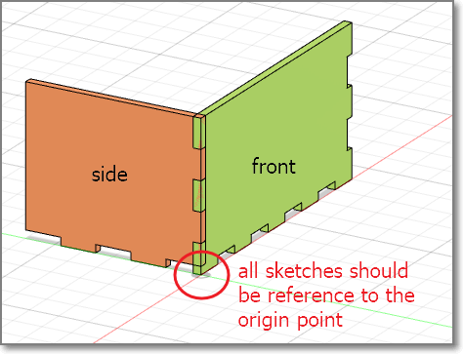
Add the side component
New component
Create sketch
Start for ORIGIN
Choose EDGE face of front tab
Constrain sketch to the front component
Draw the tabs
Extrude

Slide 8
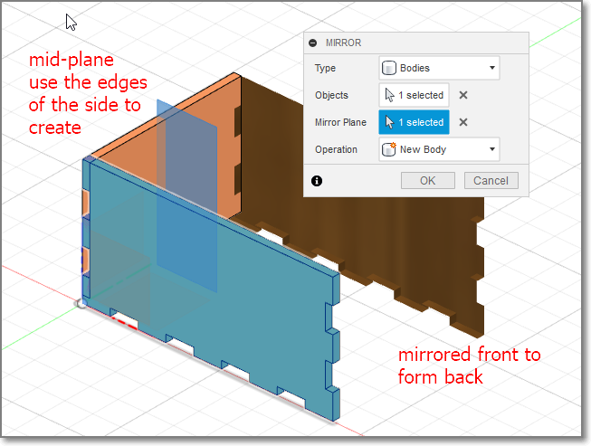
Mirror front to form back
Create a mid-plane
Switch off visibility of front body to help
Choose front and rear edges of side
Mirror the front using the mid-plane
Repeat for left and right sides

Slide 9
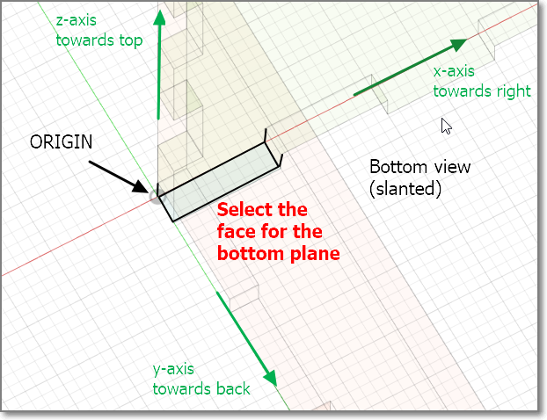
Create the base
Rotate the object to bottom view
Create new component
Create sketch
Start from ORIGIN
Sketch the base
Constraint to edges
Extrude

Slide 10
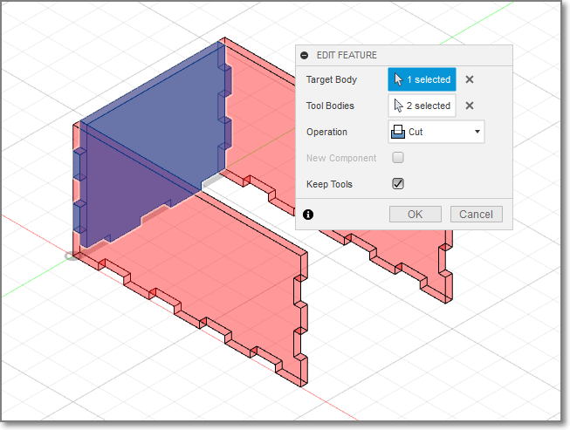
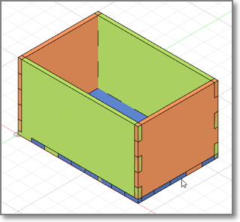
Combine
Use the combine tool to create the tabs.
Turn OFF components that are not used to improve visibility

Slide 11
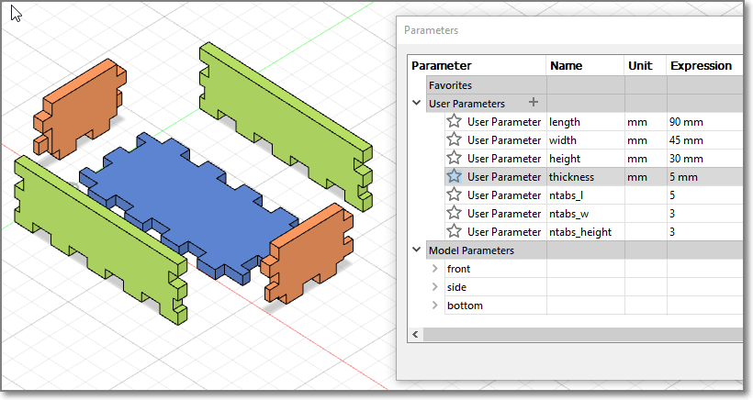
Completed Model
Change your parameters, the box should change without problems
Some parameters do not work that well (which ones, why?)

Slide 12
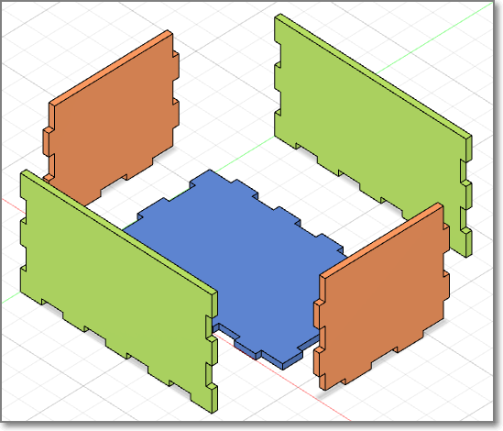
Check Model
Export and check the DXF of each of the components. Align them for laser cutting
Q: Does the thickness of the material affect the DXF output for laser cutting?

Slide 13
Assignment: Musical Box
You are to create a closed box with a movable lid, specifications are as follows:
Must have a movable lid
Must be lasercut (wood 2.5~3.6mm)
Must be able to accommodate “mechanical hand-cranked music box movement”
Drawn and modelled in Fusion 360
Can be glued together (no nails, hinges etc)
Must be “decorated” in some manner

Slide 14
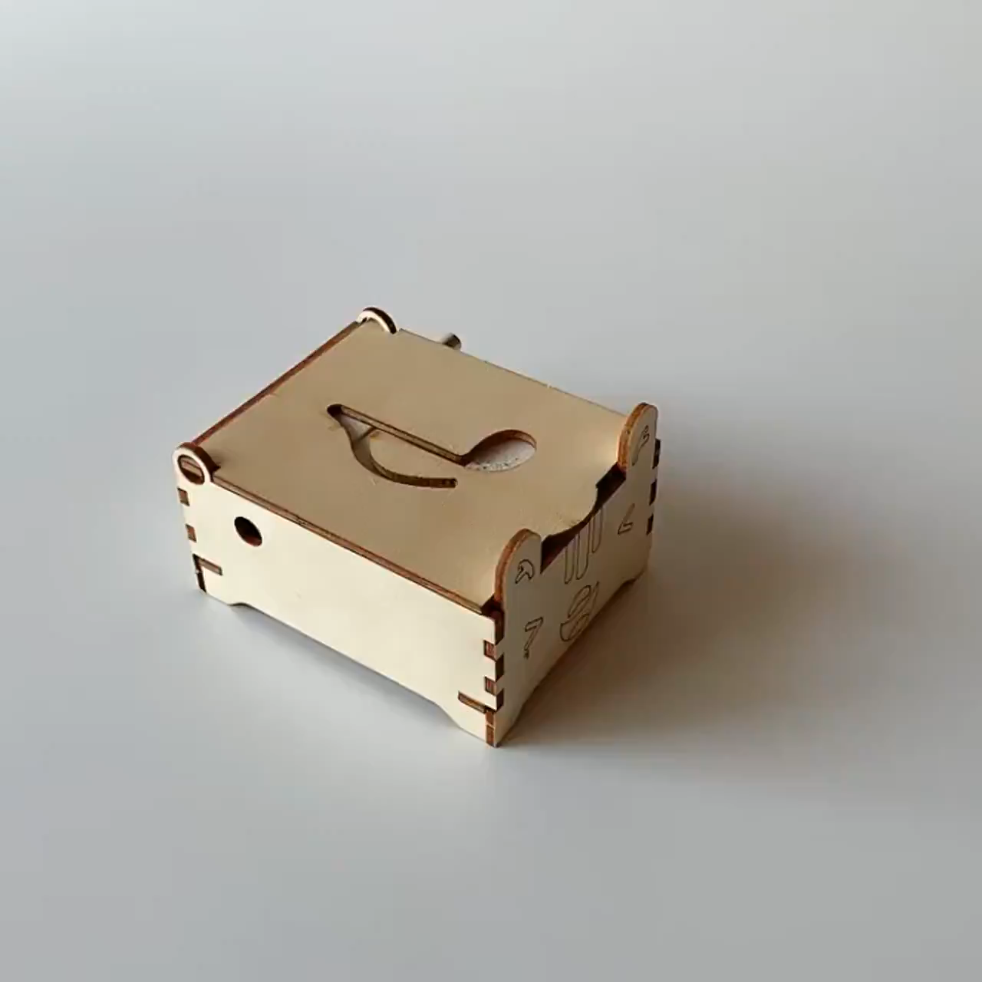
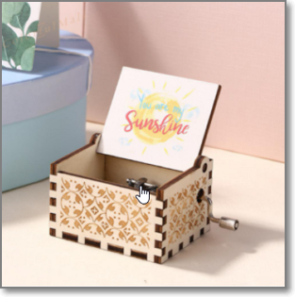
Example: Music Box
Search: Musical Box Mechanical Hand Crank

Slide 15
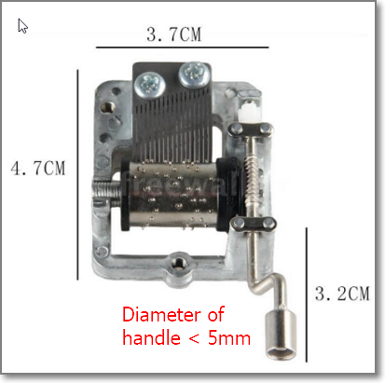
DIY Music Box
Hand Crank Musical Mechanism Craft DIY Music Box
Must accommodate musical hand crank
Measurements are approximate
You can omit the hole for the crank until the box is assembled.

Slide 16
Marking Scheme
Item | Description | Score
1 | Fusion 360 Box design (.f3d included) – 25% Lid – 25% | 50%
2 | Laser cut box fitting | 20%
3 | Write-up (how-to) | 20%
4 | Fitting, Enhancements | 10%
Deadline for submission: Friday, Week 2 Term 2 (tentative)

Slide 17
EP1000
Computer Controlled Cutting
End

Slide 18
Parametric drawings…
Some parametric drawings do not work.
The parametric changes made to the sketch (2D profile) do not carry over to the 3D model
Functions not recommended with parameters:
Sketch: rectangular/circular patterns
Sketch: mirror
Hard coded profiles
Alternative: use 3D patterns with Features instead

Slide 19
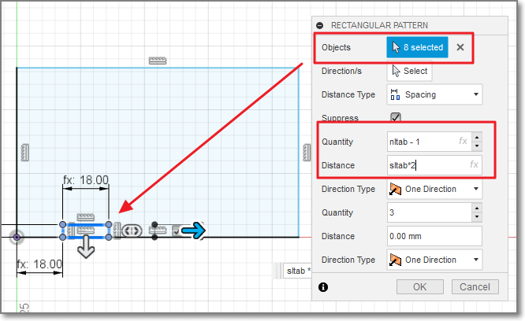
Sketch: Rectangular Patterns 1
Sketch is made using rectangular pattern with parameters

Slide 20
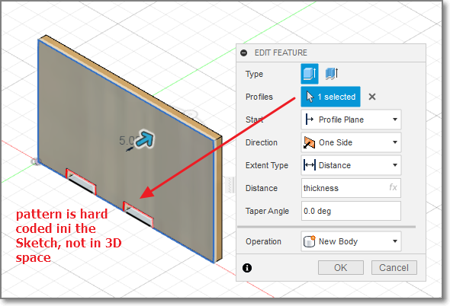
Sketch: Rectangular Patterns 2
Pattern with parameters does not exist in 3D space as extrude is done on profile

Slide 21
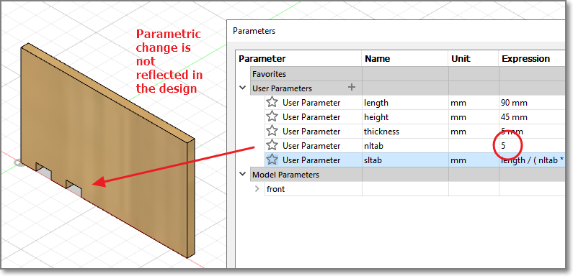
Sketch: Rectangular Patterns 3
Parametric change has no effect on 3D design

Slide 22
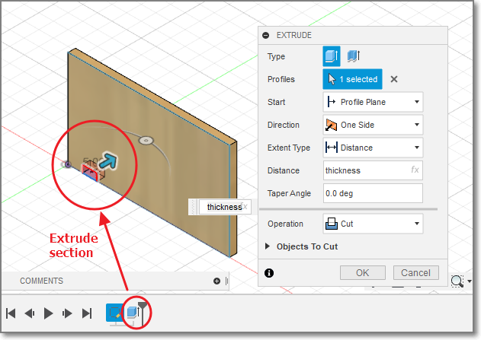
3D Parametric Features 1
Effect the feature (extrude) in 3D space

Slide 23
3D Parametric Features 2
Effect the feature (extrude) in 3D space

Slide 24
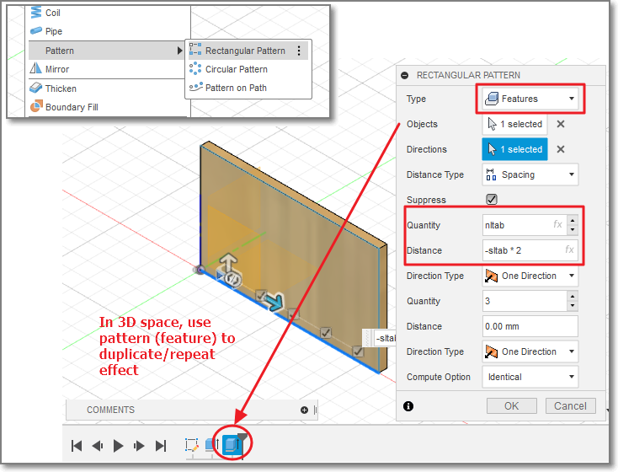
3D Parametric Features 3
Pattern the feature

Slide 25
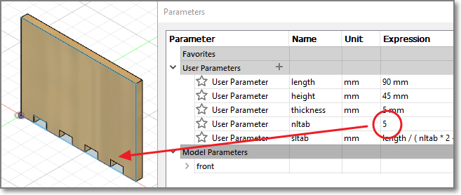
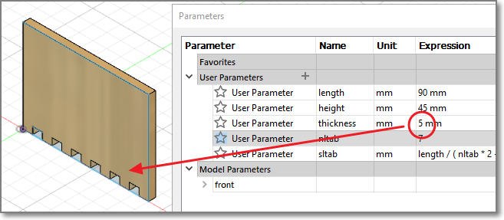
Results
Parametric design can still be applied in 3D space

Slide 26
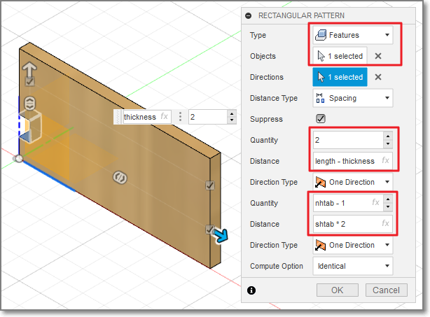
Parametric design in 2 axes
Need consideration on values to use as parameters
Perform some quick calculations and use them as the parameters
Select the proper axes/direction in which to apply

Slide 27
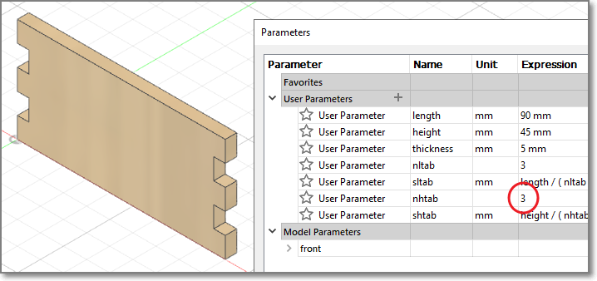
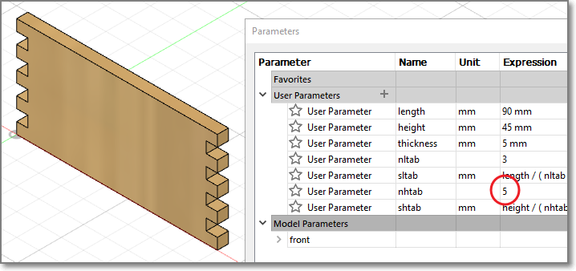
Results 2 axes

